Slide 1
The goal planning rulebook, A 4-WEEK strategy document
CPSA Meeting in a Box: A series of 15-minute guided presentations to help increase your team’s performance.
Notes:
Hitting your sales quota each quarter is no mean feat. It takes a lot of hard work and talent. But if you’re working flat out and yet consistently finding it hard to make quota, it’s natural to find yourself thinking: what more can I do? Well, the answer most likely is: a lot.
The truth is, ensuring you hit your sales quota is not as simple as having a great work ethic and attitude. It takes discipline, organisation and strategy.
Use these tips to help ensure you hit your sales quota.

Slide 2
Pre-learning:
Facilitator: One week prior to your meeting, please inform your sales team to prepare with these CPSA Learning Hub resources.
Reading:
Article: What Are the Key Goals that I Should Set for my Sales Team?
Article: How to Set Better Sales Goals and Actually Hit Them
Article: Be SMART about Goal-setting
Templates to Print: Template: 5-Step Closed-Loop Goal Setting Tool

Slide 3
WEEK 4:
ResetTING Objectives and upgrading the plan
The more activity or greater success rate, the greater the sales volume.
Notes:
In weeks 1-3 we considered what you need to get you to the level you deserve to be at – growing through training and support, enjoying your job and hitting targets.
The more activity or greater success rate, the greater the sales volume. With your new found success, comes it’s own challenges and recalibrations.. But also extra rewards!

Slide 4
Evaluating and amending goals
Make them specific with an end-in-mind e.g. I need to save (specific number) to (specific goal) by the (specific date). 2. Make them measurable - Consider creating some short-term milestones and track your progress daily or weekly depending on the overall timeline of your long-term goal. 3. Make your goals flexible - there needs to be room for change or slight slip ups in order to ensure you don't lose motivation if something changes or you have one bad month.
Notes:
When evaluating your efforts, remember the key rules of goal setting.

Slide 5
Evaluating and amending goals
4. Make your goals, your goals! Don't rely on anyone or anything else other than yourself when it comes to reaching your goals. This way there's only one person responsible for the result. 5. Make them visible - whether it's a picture of your new car, house or the top sales person’s trophy, you need ensure your goal is always visual in order to constantly be reminded of why you are doing what you are doing. 6. And last but not least, the most critical element of goal setting is thinking about the physical and mental feeling you will get when you achieve, or fail to achieve, that goal.
Notes:
When evaluating your efforts, remember the key rules of goal setting.

Slide 6
Pivoting to improve your results and get you feeling more engaged
Notes:
Before we consider ways to ramp up targets and rewards for those who’ve followed a plan and achieved most of their annual or longer term goals, we should recognize the ability of carefully crafted sales plans to help other colleagues get back on track.
People don’t always accomplish the goals that are set for them, or the goals that they set for themselves. People generally want to fulfill their roles and want to feel like they have added something positive to their organization.
If you’re struggling to hit goals, it usually doesn’t feel good for them.
That is why it is important to reflect on past goals and investigate if there were any barriers to attaining them.
It is also very important for colleagues and leaders to give feedback so people can see things about how they are accomplishing their goals that they may not have noticed themselves.

Slide 7
Pivoting to improve your results and get you feeling more engaged
Notes:
One of the hardest parts of goal-setting is making sure the goals stretch the you without making you feel stressed out and unable to perform.
Goals that are not challenging enough can create a lack of motivation, as you get bored with the tasks that you are assigned to do. Conversely, goals that are too challenging make people feel frustrated that they just can’t succeed.
Work with your sales management to raise the bar and achieve bigger goals in ways which incentivize and reward you accordingly. Not only should the big revenues you’re winning mean bigger financial incentives to keep striving, it should also provide the training and internal engagement top salespeople deserve today.

Slide 8
Take action!
Top goal-setting is in-depth. Lack of alignment at any point can make goals unattainable.
Read Be SMART about Goal-setting and discover the importance of goals setting from the top-down and it impacts your performance.
Notes:
Goals give you a benchmark to measure how well your employees are doing. Your company needs to have a clear strategy with goals of its own. These goals need to be aligned with the goals of the division. The goals of the division need to be aligned with the people who work in that division. Most importantly, an individual’s goals need to be aligned with their own capabilities and career aspirations. This is why proper goal-setting is in-depth. Lack of alignment at any point can make goals unattainable.

Slide 9
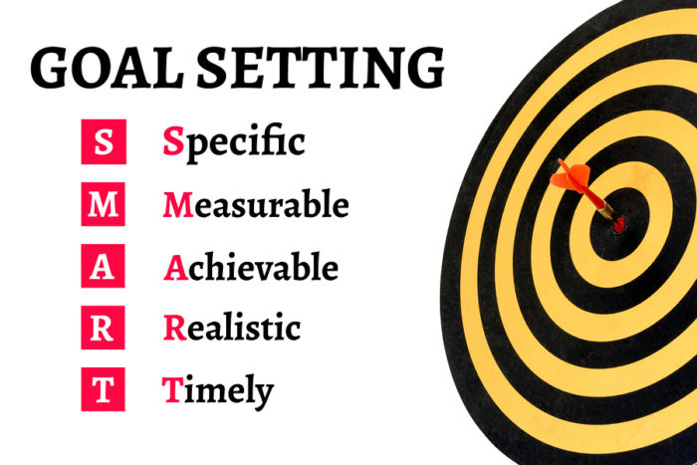
TEAM ACTIVITY
Take 10 minutes, select a partner and critique each other’s goals. Allocate 5 minutes each and be sure to measure your team mate’s goals against the SMART criteria.
Notes:
Setting goals can be challenging because of all the things that can be done wrong, but in the end they help make work life so much better. Proper goals let everyone know what they need to be doing and where they need to be. Be SMART about goal setting. Make them Specific, Measurable, Attainable, Realistic and Timely. If you do, everyone will win.
It is important that you align with S.M.A.R.T criteria so that you and your sales manager can map out your long term and short term goals, within a strategy which will help you to achieve your ultimate sales goals.
A critical element of goal setting is thinking about the physical and mental feeling you will get when you:
a) Achieve that goal or
b) Fail to achieve that goal

Slide 10
ADDITIONAL RESOURCES FROM CPSA
TEMPLATES – CPSA is constantly building and upgrading our catalog of templates to make your job easier!
WEBINARS - Our “virtual” training sessions led by industry experts, at your convenience.
PODCASTS - Take the sales experts wherever you go!
LEARNING HUB - Check out the latest sales articles, white papers, and ebooks
Notes:
Setting goals can be challenging because of all the things that can be done wrong, but in the end they help make work life so much better. Proper goals let everyone know what they need to be doing and where they need to be. Be SMART about goal setting. Make them Specific, Measurable, Attainable, Realistic and Timely. If you do, everyone will win.
It is important that you align with S.M.A.R.T criteria so that you and your sales manager can map out your long term and short term goals, within a strategy which will help you to achieve your ultimate sales goals.
A critical element of goal setting is thinking about the physical and mental feeling you will get when you:
a) Achieve that goal or
b) Fail to achieve that goal

Slide 11
GO TEAM GO!

