Slide 1
THE GOAL PLANNING RULEBOOK, A 4-WEEK STRATEGY DOCUMENT
CPSA Meeting in a Box: A series of 15-minute guided presentations to help increase your team’s performance.
Notes:
Hitting your sales quota each quarter is no mean feat. It takes a lot of hard work and talent. But if you’re working flat out and yet consistently finding it hard to make quota, it’s natural to find yourself thinking: what more can I do? Well, the answer most likely is: a lot.
The truth is, ensuring you hit your sales quota is not as simple as having a great work ethic and attitude. It takes discipline, organisation and strategy.
Use these tips to help ensure you hit your sales quota.

Slide 2
PRE-LEARNING:
Facilitator: One week prior to your meeting, please inform your sales team to prepare with these CPSA Learning Hub resources.
Reading:
Article: What Are the Key Goals that I Should Set for my Sales Team?
Article: How to Set Better Sales Goals and Actually Hit Them
Article: Be SMART about Goal-setting
Templates to Print: Template: 5-Step Closed-Loop Goal Setting Tool

Slide 3
WEEK 3:
WEEKLY PLANNING AND EVALUATING YOUR CALLS:
Big Picture first, but don’t forget the details!
Notes:
Goals without a plan don’t work. As mentioned, goals need structure. You should have a clear idea of what the way forward will look like before you commit to any concrete sales goals. A comprehensive action plan should include a process to measure and evaluate your calls on a regular basis.
Likewise, it should include the realistic goals and timeframes we discussed in weeks 1 and 2.

Slide 4
WEEKLY PLAN
# of sales calls per year = [A x 5] x B x C | A=Daily Activity (number of client interactions)
B = Overall Average Success Rate (avg. # of orders or commitments / avg. # of visits) | C = Overall Average Value (avg. size of order or gross margin or volume)
Notes:
Simply setting and measuring goals is not enough to produce the professional development you deserve. Your sales leadership team should provide guidance and support in helping you achieve your short and long term goals, as well as praise for your perseverance determination.
When the structure is in place, monitoring all of these areas will enable to you manage and retain a strong and cohesive sales approach which will deliver you with the best results in a way which makes you feel like you want to keep striving for the next challenge.
Examples of questions to ask around various goals are shared here.

Slide 5
EVALUATE YOUR ACTIVITY: REVIEW YOUR ACTIONS AFTER EACH CALL
Notes:
There are several goals that are worth assessing depending on your business goals. You should aim to set goals around productivity, revenue generation, as well as personal and professional development.
Set time to review your last call and make notes to help you find patterns and goals around identified areas for improvement. And don’t forget to role play with colleagues so they can critique.

Slide 6
EVALUATE YOUR ACTIONS: PATTERNS AND DUTIES
Productivity: - How many new leads did you generate this week? - How many follow-up calls did you make this week? - How many quickly were you able to move through the sales cycle on average for the sales you made this week? - How many large accounts vs. one-offs did you engage this week?. | Revenue generation: - How many conversions did you see this week? - Total dollar value for sales made this week? - New dollar amount for sales in pipeline this week?
Personal Development: - What new personal habits did you develop/reduce this week to increase productivity? - What coping methods did you employ this week to deal with all the Nos you’ve encountered - How have you worked on developing a more positive attitude? | Professional Development: - Which webinars have you attended this month - What new industry/product knowledge/insights have you gained recently - Which sales training courses are you planning on taking
Notes:
Simply setting and measuring goals is not enough to produce the professional development you deserve. Your sales leadership team should provide guidance and support in helping you achieve your short and long term goals, as well as praise for your perseverance determination.
When the structure is in place, monitoring all of these areas will enable to you manage and retain a strong and cohesive sales approach which will deliver you with the best results in a way which makes you feel like you want to keep striving for the next challenge.
Examples of questions to ask around various goals are shared here.

Slide 7
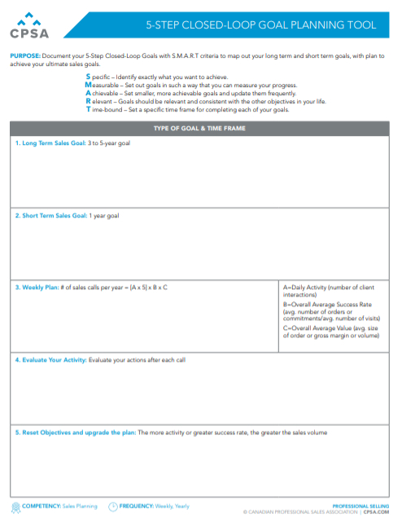
TAKE ACTION!
This tool will help you to document your 5-Step Closed-Loop Goals with S.M.A.R.T criteria to map out your long term and short term goals, with plan to achieve your ultimate sales goals.
DOWNLOAD NOW: 5-STEP CLOSED-LOOP GOAL SETTING TOOL
Notes:
https://www.cpsa.com/resources/articles/uvp-creation-competitive-advantage-tool

Slide 8
ADDITIONAL RESOURCES FROM CPSA
TEMPLATES – CPSA is constantly building and upgrading our catalog of templates to make your job easier!
WEBINARS - Our “virtual” training sessions led by industry experts, at your convenience.
PODCASTS - Take the sales experts wherever you go!
LEARNING HUB - Check out the latest sales articles, white papers, and ebooks
Notes:
Setting goals can be challenging because of all the things that can be done wrong, but in the end they help make work life so much better. Proper goals let everyone know what they need to be doing and where they need to be. Be SMART about goal setting. Make them Specific, Measurable, Attainable, Realistic and Timely. If you do, everyone will win.
It is important that you align with S.M.A.R.T criteria so that you and your sales manager can map out your long term and short term goals, within a strategy which will help you to achieve your ultimate sales goals.
A critical element of goal setting is thinking about the physical and mental feeling you will get when you:
a) Achieve that goal or
b) Fail to achieve that goal

Slide 9
GO TEAM GO!

