Slide 1
Developing client-focused solutions presentation skills – week 1 preparing for YOUR STRONGEST PRESENTATION
CPSA Meeting in a Box: A series of 15-minute guided presentations to help increase your team’s performance.

Slide 2
Pre-learning:
Facilitator: One week prior to your meeting, please inform your sales team to prepare with these CPSA Learning Hub resources.
Reading: Presentations Checklist
The Elements of a Winning Sales Presentation

Slide 3
WEEK 1:
introduction:
The opportunity to pitch to a prospect is huge - you only get one shot to make a great first impression and win their business. Preparation is the key to success. Of course, great sales reps are skilled at thinking on their feet, but you don’t want to leave everything to chance. A well thought out sales presentation which has been effectively tailored to your prospect is a must. Here are the key factors to consider as you are preparing for a sales presentation.

Slide 4
Who am I presenting to?
Knowing your prospects is key if you want your presentation to be appealing. Uncovering as much as you can about the people who will be in the room is important; so do your research
Notes:
If you can get intel on their positions/roles in the company and buying process; likes/dislikes; personalities/communication styles; and why they are in the market for what you’re selling, then your presentation will be that much more personalized and persuasive. Of course, it’s not always possible to know exactly who will be in the room, but at the very least you can investigate the company and its goals as well as key decision makers, even if you’re not sure they’ll be there on the day.

Slide 5
WHAT QUESTIONS CAN I ASK TO START A DIALOGUE?
Through your research and discovery questioning, you should have a pretty detailed understanding of the customer’s business pain and how your solution can solve it. However, that doesn’t mean you just want to walk into the room and talk at them for 20 minutes. Plan insightful questions ahead of time and use them throughout your presentation to continue a dialogue. Not only does this give you the opportunity to better tailor your points to the audience in front of you, psychologically it makes your buyers feel a part of the process; as if this is a problem you are all solving together; thus increasing their buy-in to your solution.
Notes:
A word of warning, if you are going to start a dialogue then you must actually listen to their answers and respond to them appropriately. Sometimes, when we’re feeling nervous we can end up sticking too rigidly to a script or plan. If you ask questions in your sales presentation, then you must be prepared to adapt, think on your feet and change your presentation as is appropriate.

Slide 6
How can I make this humorous and engaging?
Storytelling, video, AI, humor, imagery and audience involvement are all winning tactics but ensure the ones you choose to include are ones you can actually pull off AND won’t leave your audience feeling uncomfortable. For example, having your audience call out answers in a large group won’t go down well if they are introverted. Similarly, if humor isn’t your strong point, starting with an amusing anecdote is unlikely to pan out well for you.
Notes:
No one wants to look out at their prospects and see yawning faces or sneaky looks at cell phones or watches. If your sales presentation is boring then you’ve already lost your buyer. Spend time thinking about what you can do to make your presentation interesting to the audience in front of you. Importantly, also consider your own strengths.

Slide 7
WHAT IS MY FOLLOW-UP PLAN?
There are many ways to rescue a failing presentation but if you walk away and never hear from them again, then you’ve really failed. Try and end the meeting by scheduling your next interaction. A good practice is to schedule a follow-up meeting to discuss a cost-proposal.
Opportunities and reasons for follow-up may arise during the presentation, but make sure you have a plan or reason for another meeting in the event that they don’t.
Notes:
The point of a sales presentation is to sell. You must go into your meeting with a strategy to move the sales process along, neglecting to consider this is perhaps one of the greatest errors you can make.

Slide 8
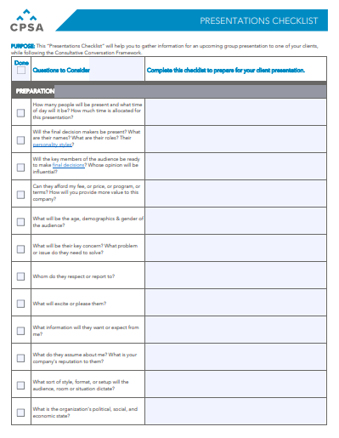
Take action!
Use this “Presentation Checklist” from the CPSA each time you prepare for a presentation!
This “Presentations Checklist” will help you to gather information for an upcoming group presentation to one of your clients, while following the Consultative Conversation Framework.
DOWNLOAD NOW.

Slide 9
ADDITIONAL RESOURCES FROM CPSA
TEMPLATES – CPSA is constantly building and upgrading our catalog of templates to make your job easier!
WEBINARS - Our “virtual” training sessions led by industry experts, at your convenience.
PODCASTS - Take the sales experts wherever you go!
LEARNING HUB - Check out the latest sales articles, white papers, and ebooks

Slide 10
GO TEAM GO!

